Slide 1
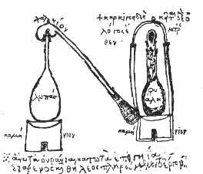
Metadata from CSDGM to ISO 19115
Metadata Alchemy 101
National Agricultural Library
Introduction to ISO Metadata Series
Jeffrey Campbell
Jeffrey.Campbell@usda.gov
First Draft Not ready for distribution

Slide 2
Agenda
Core ISO concepts
Conversion strategies
“What can possibly go wrong?”

Slide 3
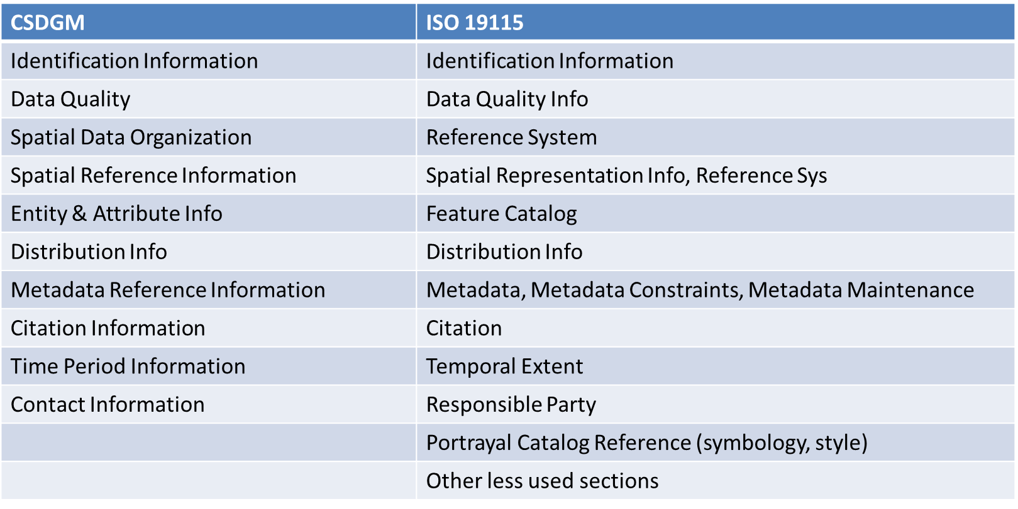
CSDGM content remains in ISO 19115
Notes:
With only a few exceptions, all metadata elements in the legacy CSDGM format are in ISO. They have been reorganized and the element names have changed but the usage and meaning is generally the same. There is documentation that maps between the element names and locations in CSDGM and ISO.

Slide 4
ISO Geospatial Metadata Structure
ISO reuses elements in many places. For example, a ResponsibleParty could identify the author of the metadata, an organizational point of contact, or other places where person/organization/position is needed.
Metadata are stored in XML files, not plain text allowed for CSDGM.
XML strictly enforces the format of the metadata file. (Validation with schema)
Fewer required metadata elements, but
“Mandatory if applicable” is a new category of elements
“nilReason” (unknown, missing, not applicable…) can be explain why there is no value. nilReason is not allowed for all metadata elements.
Controlled vocabulary can (should) be associated with the source. This improves search results looking for particular types of data.
Notes:
A nice example of nilReason usage is for the date range for the data. There is a nilReason of XXX to indicate that data is continuing to be collected so there is no valid end date value.
Controlled vocabulary examples: FIPS codes, USDA Agency and organizational units, watershed (HUC) codes, National Agricultural Library Thesaurus (NALT).
NALT uses “precipitation, atmospheric” and “precipitation, chemical” This improves search results by not including the “wrong” type of precipitation. The clear distinction also benefits machine learning, artificial intelligence and other emerging technologies.

Slide 5
Esri Conversion Strategies
Probably best if the metadata is already written in Esri products:
ESRI originally stored metadata internally in a format that did not correspond to any open standard, but the software could export the information in open standard(s), including CSDGM and ISO 19115.
Potential Complexity and Variability
Esri’s internal metadata format varies between products (desktop, pro, AGOL and versions/releases (e.g., 9.x, 10.1, 10.2))
GeoPackages from the current ArcGIS Pro do NOT include metadata.
Metadata may not always transfer between products (For a time, metadata was lost going from desktop to AGOL.)
At least for the newer versions, opening a GIS layer in a newer version will update the format of the metadata for that layer.
In some products (early 10.x?) the user had to select a metadata style (standard). This had some impact on the user interface and/or mapping between the UI and the internal metadata format.
The internal format is proprietary (full definition apparently not public). However, there are XML transforms in Esri open source code.
Disclaimer: Based on current knowledge and understanding. Their approach to metadata has been fairly dynamic over the last few years so investigate particular details to select conversion strategy.
Notes:
Note: Exporting a valid standard metadata record is different from fully supporting the standard. (If something is not in the proprietary format, it could not be exported)

Slide 6
CSDGM (XML) Conversion Strategies
Use XML Transforms – one to create base ISO 19115 and another for the Feature Catalog (ISO version of CSDGM entity-attribute section).
XML Transform (.xsl, .xslt) is a coding language that selects elements from an XML file and outputs another file. Output to an XML file based on another definition (schema) is the way to convert from one xml format to another.
The file could also be output as HTML or even plain text, csv file depending upon the xsl code written.
There are existing transform code to convert from CSDGM to ISO.
The transform can be modified to add static information (for example, to add controlled vocabulary terms, such as the Federal Bureau code or other administrative information required by data.gov but not specifically in CSDGM or ISO.

Slide 7
CSDGM (XML) Transforms at NAL
CSDGM to Feature Catalog
File Name: CSDGM-to-ISO19110.xsl
GeoData import process name: FGDC CSDGM to Feature Catalog
This transform reads CSDGM metadata in xml format, and generates the ISO Feature Catalog (ISO 19110, part of the 19115 standards family) from information in the CSDGM Entity Attribute (eainfo) element.
CSDGM to ISO 19115
File name: CSDGM-to-ISO19115-3.xsl
GeoData import process name: FGDC-to-19115-3 (will be updated in the next release)
The generally available transform from CSDGM to ISO creates an ISO 19115-2 file since -2 includes remote sensing enhancements that were not available in the original ISO 19115 standard. The newest ISO, 19115-3 includes all of -2 plus some other additions.
The NAL recommendation that it makes more sense to convert to the newest ISO version. This transform accomplishes this in two steps. The first transforms CSDGM to ISO 19115-2 (CSDGM-to-ISO19115-2.xsl) and the second transform (ISO19115-2-to-ISO19115-3.xsl) is the official -2 to -3 transform. Official in the sense of being provided by ISO
Note: the -2 to -3 conversion??? requires XSL Transformations (XSLT) Version 2.0. Python uses open license XSLT 1.0, so running the transform of python is not successful with the usual libraries. Open source XSLT 2.0 has not had a suitable open license. It is possible this will change in the future.

Slide 8
CSDGM (non-XML) Conversion Strategies
Convert to XML than transform from there
The USGS tools for CSDGM management have a program that interprets the indentation of lines in the metadata record to create an XML file.
The tool works best with CSDGM that was written in text format using their software.
We have not conducted tests to evaluate sensitivity to variations in the text format. Our general understanding is that it is fairly sensitive.

Slide 9
Non-file (Database, etc.) Conversion Strategies
Various Design Approaches
If there is a current system that creates CSDGM, output the CSDGM and transform to ISO
If there is substantial similarity in content (e.g. NAIP) consider creating metadata snippets (standalone metadata elements) that can be reused in many metadata records. GeoData supports such reuse. The underlying xlink technology could be accomplished using other code if needed.
Create ISO metadata template with replaceable parameters with values provided from the database. (search/replace or regular expressions.)
Worked well for pilot test at NAL for aerial imagery where there was a spreadsheet of details about each image and processing.
This was a simple test since it did not involve repeating elements with different values in a single record.
For example, we put the county FIPS code in the spreadsheet and it worked well. The simple search/replace would not have worked for multiple FIPS codes for a single image.
Write code to generate XML element chunks and assemble them in the proper (ISO schema) sequence.
Reconsider other alternatives, this is euphemistically called “non-trivial.:
There are some open source code projects that have taken this type of approach using various code languages.
NAL can provide additional information

Slide 10
Non-CSDGM standard Conversion Strategies
Various Design Approaches
Extract metadata using OGC web services
Probably most useful for creating ISO Feature Catalogs (enhanced version of CSDGM entity attribute section)
Extract geospatial critical information ((EPSG code, bounding box, etc.)
Note, we wrote (or found) a transform that will extract this information from ArcGIS 10 metadata.
OGC Catalog Services for the Web (csw)
Can obtain metadata from other portals/catalogs that support queries using csw
Search for other tools that support a different metadata standard to identify direct or indirect conversions to ISO
GeoData can support various other metadata standards including many basic bibliographic and general data interchange standards.
NAL has transformations in GeoData to support ingest and conversion of Ecological Metadata Language (of potential interst to ARS and FS researchers)
If the data has a DOI: (Digital Object Identifier), the metadata submitted with the DOI request should include at least the bounding box.

Slide 11
What could possibly go wrong?
The output ISO metadata record is only as good as the source content.
XML file transformation relies upon “well-formed” (quotation marks match, blocks of xml properly marked with open and close symbols) and valid (follow all the rules for elements and contents).
CSDGM intended for web display with HTML markup generally is invalid
Variability in usage of CSDGM metadata elements
Agency/location/person putting information in different elements makes a transform much more complex
Variation in content (e.g. disclaimer) that is outdated
Inconsistent names for thesauri identifying term sources in CSDGM

Slide 12
What else could possibly go wrong?
How standard is a standard?
CSDGM has two main versions, plus Biological, Remote Sensing, and XXX enhancements. Most transforms only handle one variety.
ISO 19115 also has multiple versions. Our current approach is to make the differences transparent to most people using GeoData.
XML file transformation relies upon “well-formed” (quotation marks match, blocks of xml properly marked with open and close symbols) and valid (follow all the rules for elements and contents).
CSDGM catch-all element abuse
Information in the catch-all element is quite difficult to process with a transform. For example, a record with the EA info as free text will not be detected by the transform extracting EA info in the proper location to create and ISO Feature Catalog.
Catch all info is at risk of getting lost in translation.
Notes:
We anticipate that the default metadata in GeoData will be in the newest version of ISO 19115 but easily saved as the original version (which is still most widely used). Esri apparently has future plans to create metadata in the newest format.

Slide 14

Metadata alchemy - Convert Legacy to golden ISO Metadata
Legacy format | Strategy
Esri metadata (product and version specific) | Use Esri to extract ISO from internal metadata
FGDC (CSDGM) (in valid XML format) | XML transform moves CSDGM elements to ISO format
FGDC (CSDGM) text only or non-standard format | Manual or code correction then transform
Metadata assembled from database/files | Fill-in-the-blank (search & replace) logic in ISO template
Other metadata standards (for example, Ecological Metadata Language | Find or create an existing conversion program or transform if effort is less than manual conversion
Main point: There are many approaches to turning legacy metadata into ISO.
Disclaimer: Kids don’t try this at home. Your mileage will vary. These are general approaches that NAL has prototyped to varying extents. Results of automated conversion depends upon legacy file contents.

